Slide 1
LOAN MANAGEMENT SYSTEM

Slide 2
SUBMITTED BY
JAGADEESH R – 2021506314

Slide 3
TABLE OF CONTENTS
1.
4.
2.
5.
3.
6.
PROBLEM STATEMENT
DATA FLOW
OBJECTIVES
ER DIAGRAM
SCHEMA
OUTPUT SCREENSHOTS

Slide 4
1
PROBLEM STATEMENT

Slide 5
To automate every stage of a loan life cycle, from application to closing.

Slide 6
2
OBJECTIVES

Slide 7
OBJECTIVES
FACILITATIONS
SWIFTNESS
To provide good interaction & communication facilities between customers &
administrator.
To provide interest rate and loan details at a mouse click.
DIGITISATION
BETTER TRACKING
Using with this system admin can find customer easily and it’s a paperless system, so workload is reduced.
Customer can apply for a loan and after approval, admins can track their details online.

Slide 8
3
SCHEMA

Slide 9
borrowers(id, firstname, middlename,lastname, contact_no,address, email, tax_id, date_created);
loan_list(id, ref_no, loan_type_id, borrower_id, purpose, amount, plan_id, status, date_released, date_created);
loan_plan(id, months, interest_percentage, penalty_rate);
loan_schedule(id, loan_id, date_due);
loan_types(id, type_name, description);
payments(id, loan_id, payee, amount, penalty_amount, overdue, date_created); users(id, doctor_id, name, address, contact, username, password, type);

Slide 10
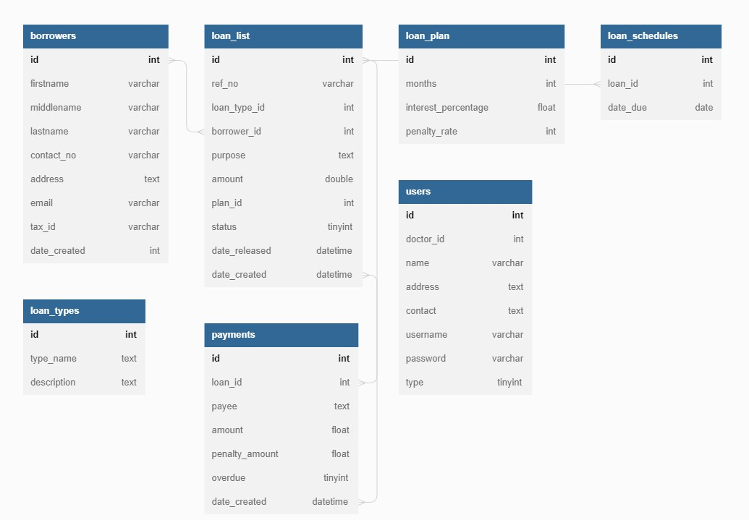
SCHEMA DIAGRAM

Slide 11
4
DATA FLOW

Slide 12
INPUT DATA:
Customer details (name, address, mobile number, email, etc) and details regarding the loan they want to take (loan type, loan amount, monthly income, etc) is received as the input.
OUTPUT DATA:
Generated report on Loan Amount payment after verification of customer details from the admin side will be provided to that respective customer.

Slide 13
5
ER DIAGRAM

Slide 14
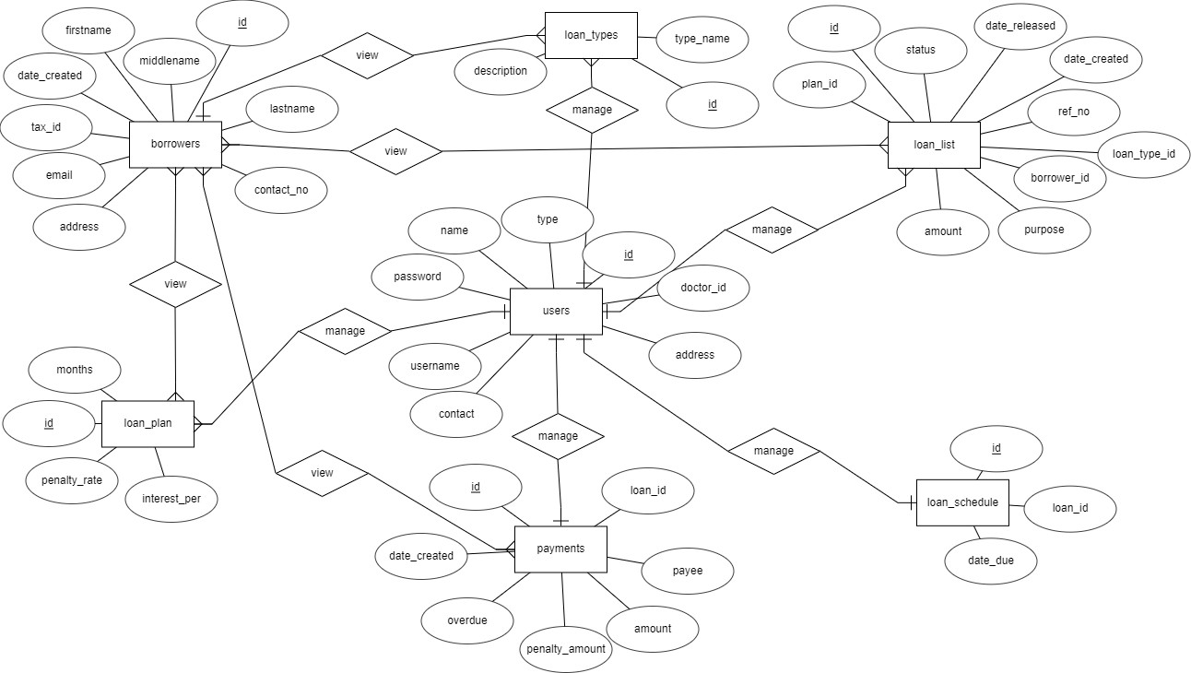
ER DIAGRAM

Slide 15
6
OUPUT SCREENSHOTS

Slide 16
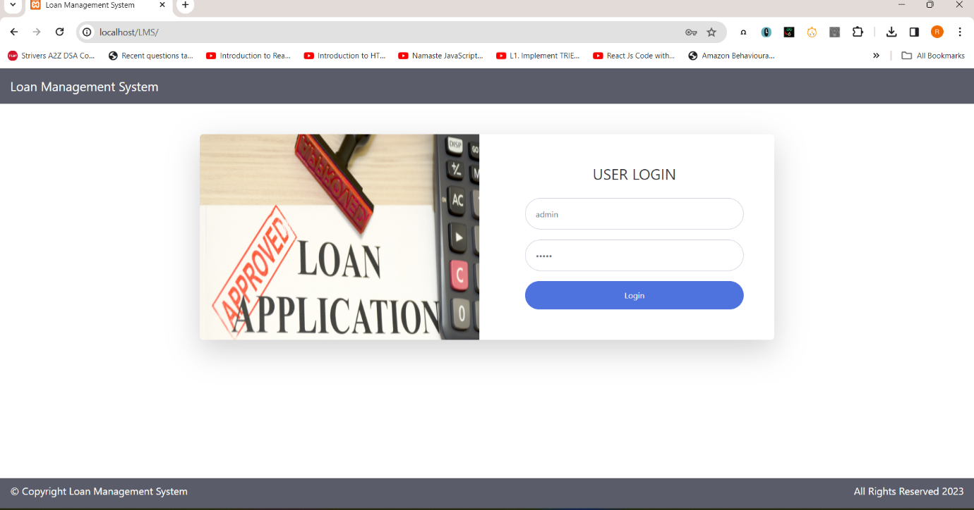
LOGIN PAGE

Slide 17
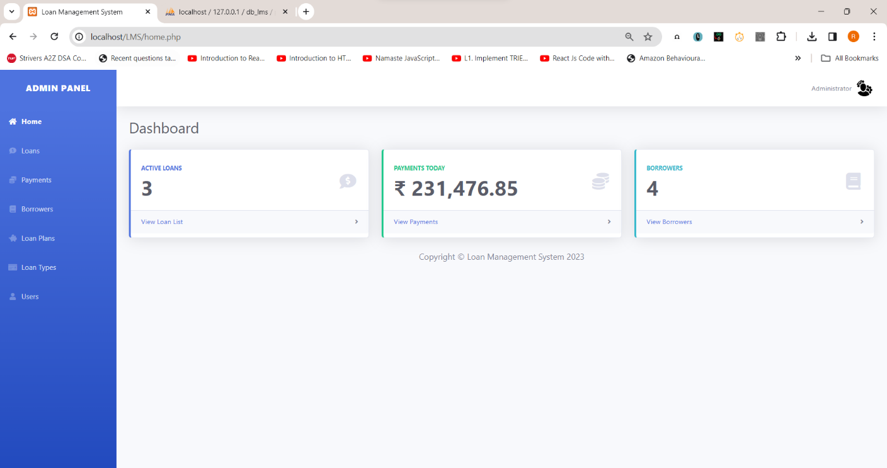
HOME PAGE

Slide 18
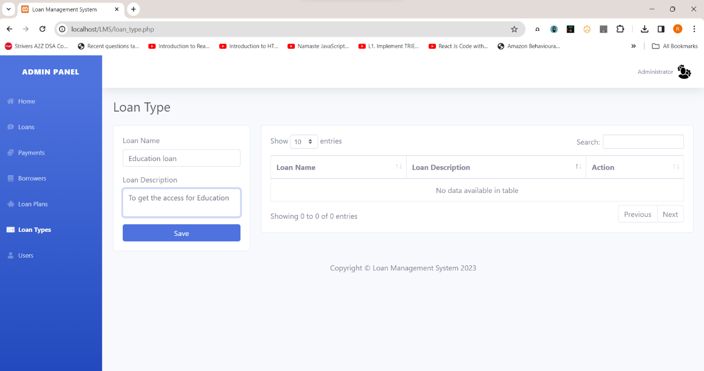
ADDING LOAN TYPES

Slide 19
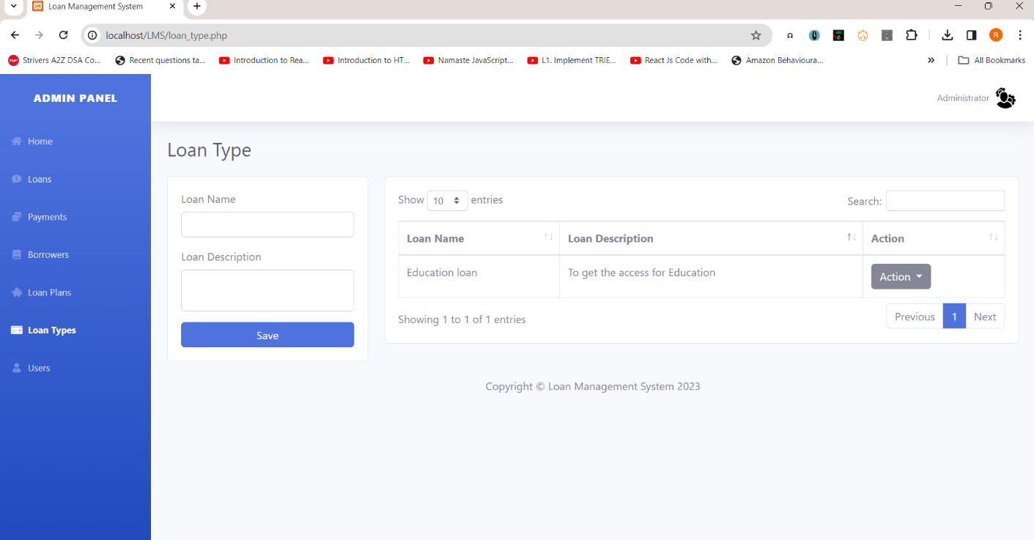
AFTER CLICKING SAVE

Slide 20
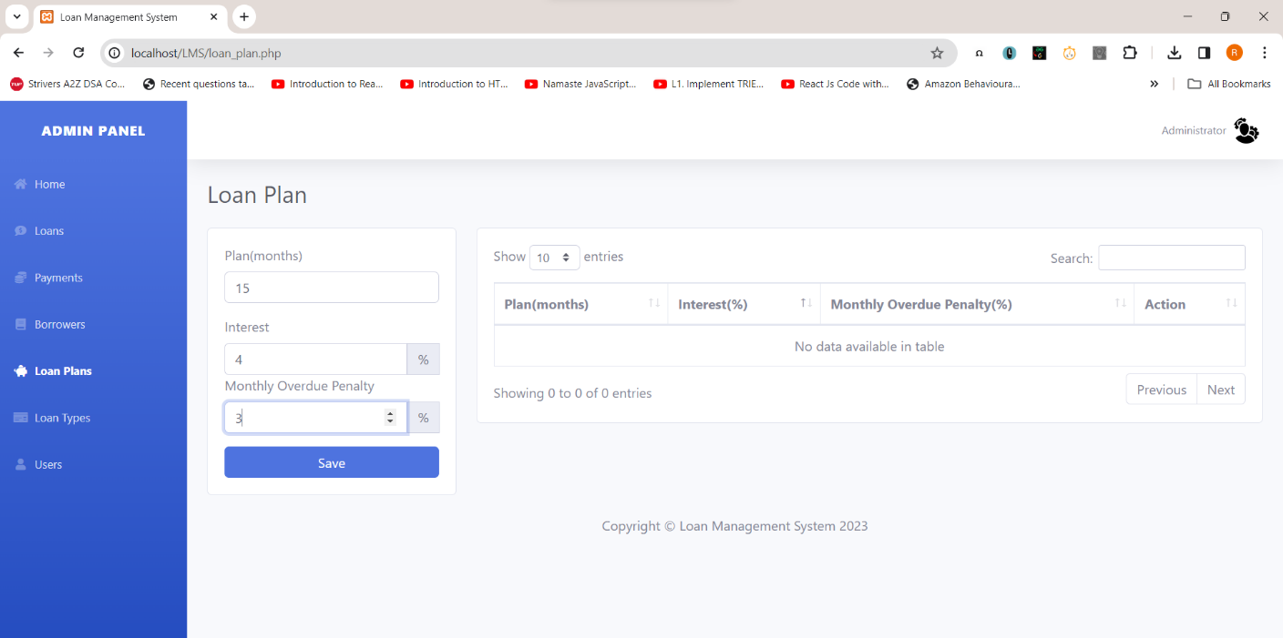
ADDING LOAN PLANS

Slide 21
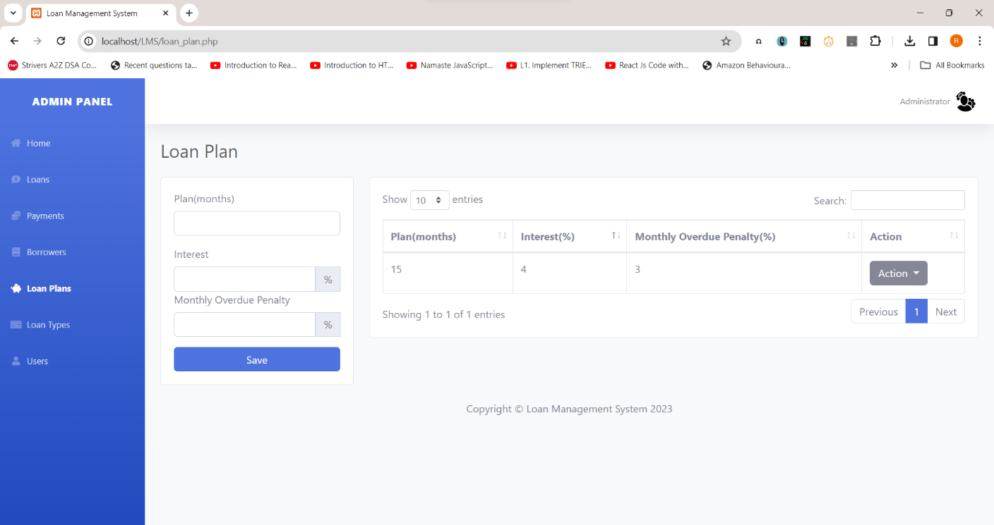
AFTER CLICKING SAVE

Slide 22
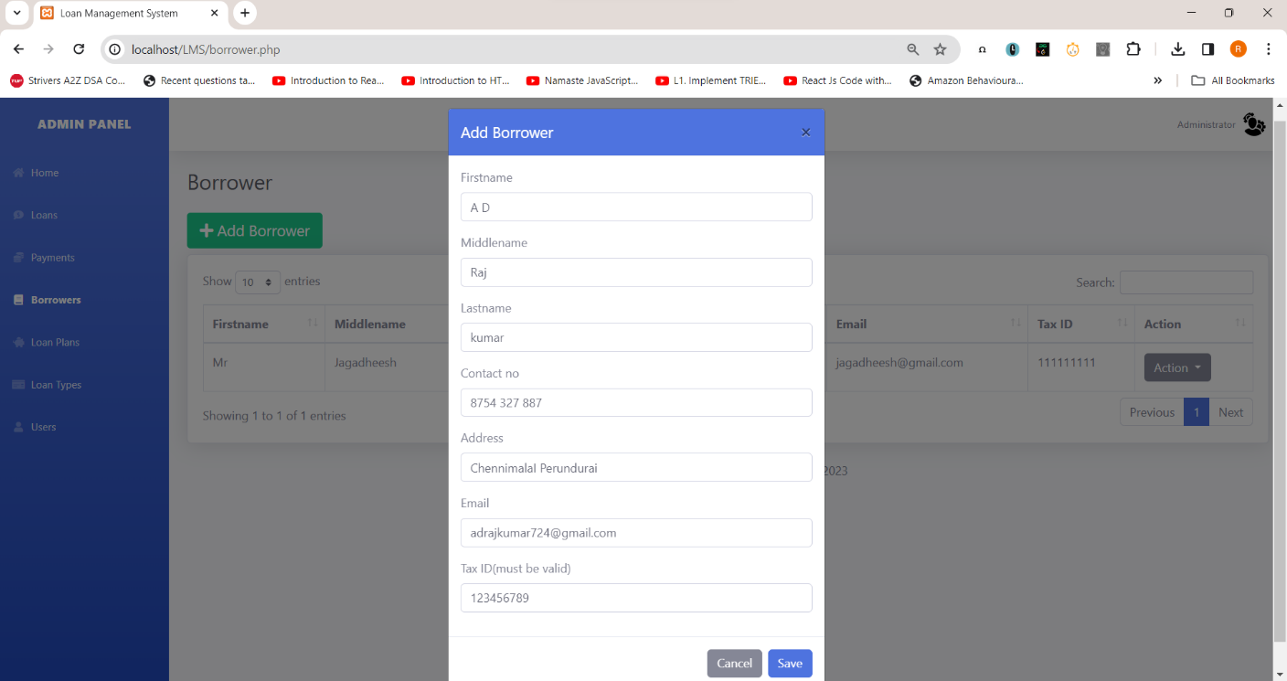
ADDING NEW BORROWER

Slide 23
ADDING BORROWER DETAILS

Slide 24
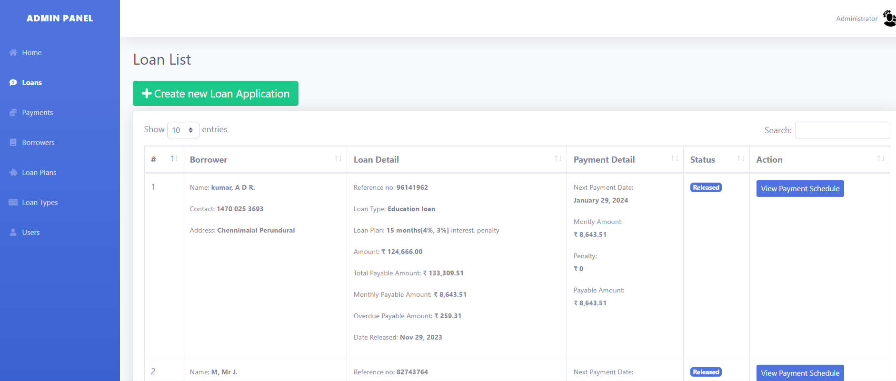
LOAN PAGE

Slide 25
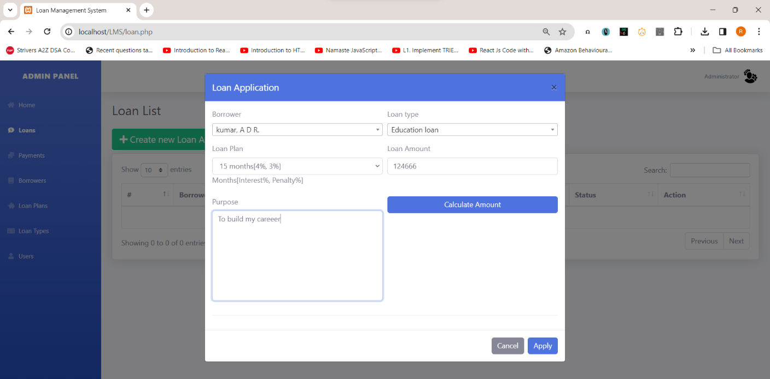
ADDING NEW LOAN APPLICATION WITH DETAILS

Slide 26
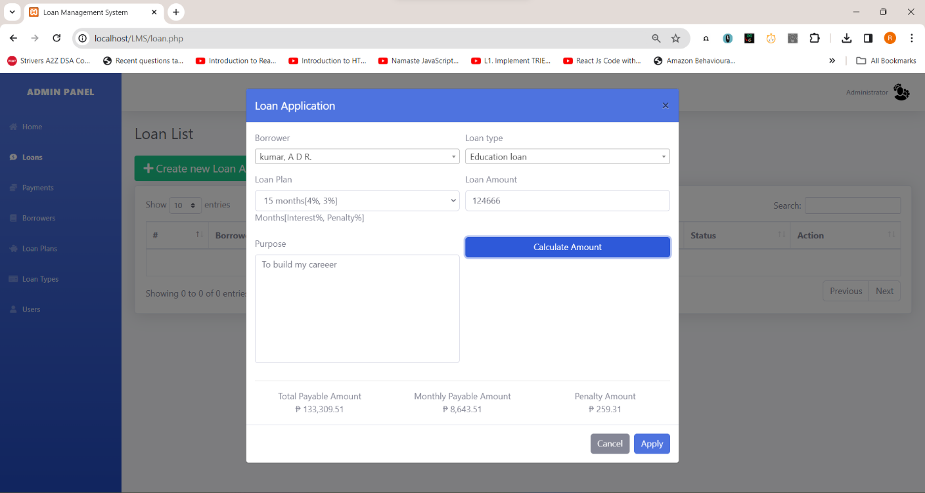
CALCULATING THE AMOUNT

Slide 27
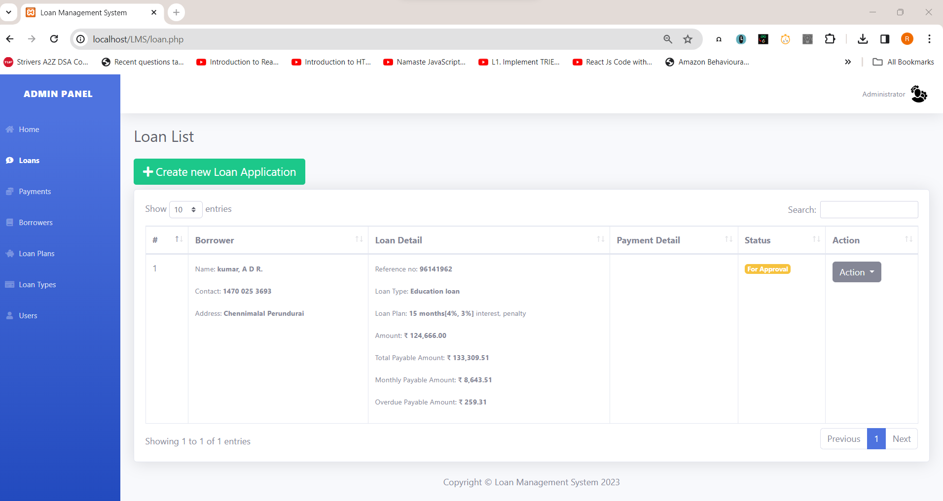
ADDED LOAN WAITING FOR THE FOR APPROVAL

Slide 28
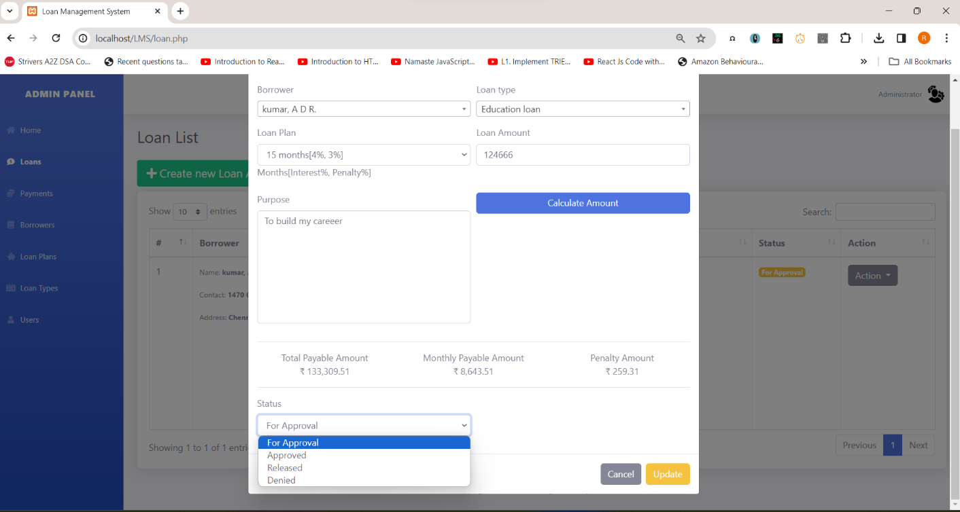
APPROVING THE LOAN

Slide 29
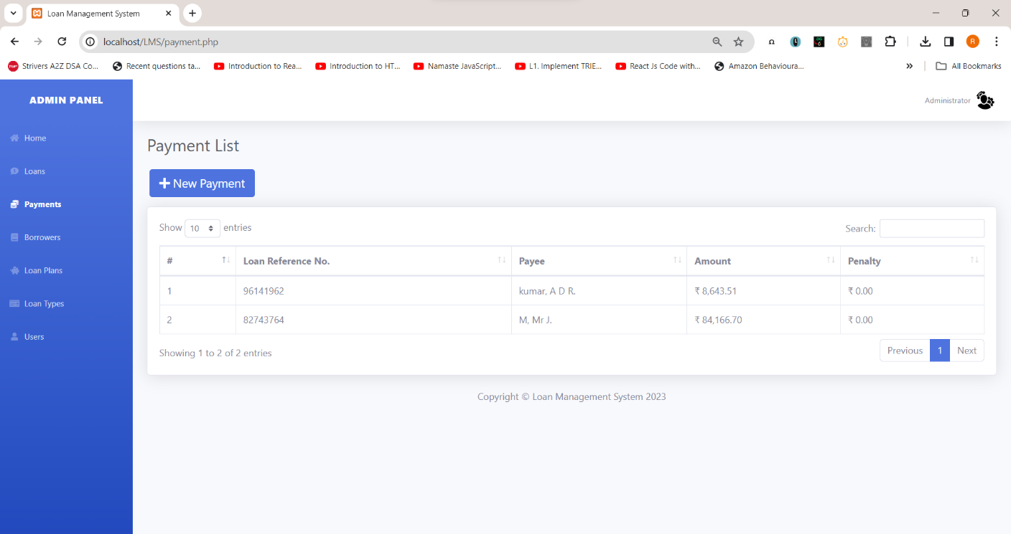
PAYMENT PAGE

Slide 30
CLICKING SAVE AFTER ADDING A PAYMENT

Slide 31
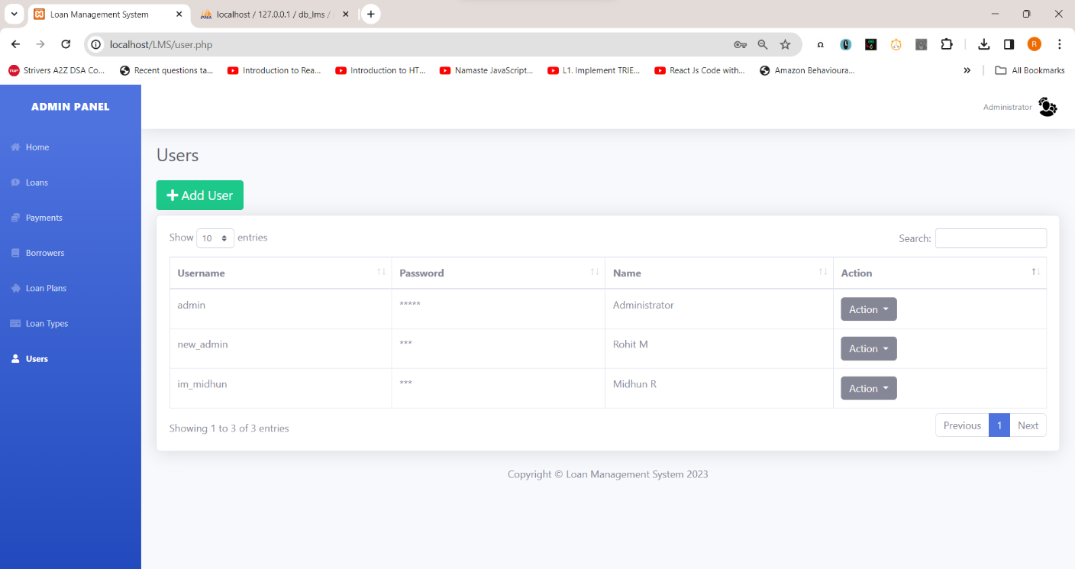
ADDING NEW USER IN USER PAGE

Slide 32
NEW USER IS ADDED

Slide 33
7
CONCLUSION

Slide 34
The Loan Management System (LMS) is a comprehensive, user-friendly solution designed to optimize the entire lifecycle of loans, from application to repayment. With its robust features and functionalities, the LMS provides significant benefits to both customers and administrators.
The LMS enhances interaction and communication between customers and administrators, provides real-time insights, and promotes a paperless environment, making it a valuable asset for any lending institution.

Slide 35
THANK YOU

